Slide 1
Weakly Supervised Localization
Sungjoon Choi
(sungjoon.choi@cpslab.snu.ac.kr)
Learning Deep Features for Discriminative Localization Bolei Zhou, Aditya Khosla, Agata Lapedriza, Aude Oliva, Antonio Torralba
Based on Junho Cho’s slide (@PIL SNU)

Slide 2
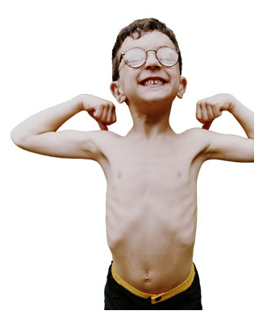
Weakly Supervised?

Slide 3
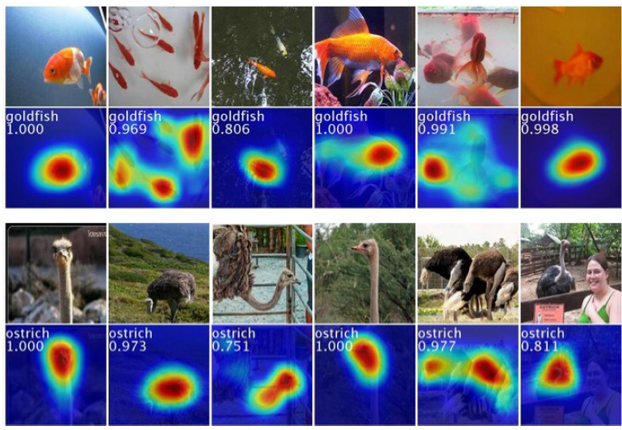
Introduction

Slide 4
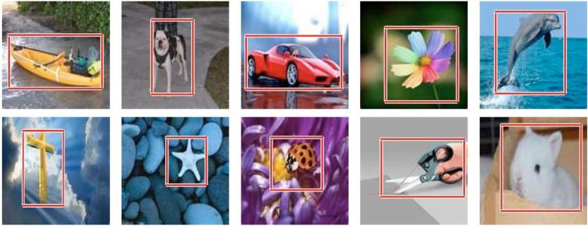
Introduction
Learning Deep Features for Discriminative Localization – CVPR2016
Weakly supervised object localization
Only trained with class label on image
Yet able to localize object very well
Close to fully supervised learned AlexNet

Slide 5
Introduction
Learning Deep Features for Discriminative Localization – CVPR2016
Visualizing the internal representation of CNNs.
Localization by Class Activation Map (CAM)
Units activated by some visual pattern within its receptive field
Visualize what activates for the output
in One CNN forward pass.

Slide 6
Weakly Supervised Object Localization
Usually supervised learning of localization is annotated with bounding box
What if localization is possible with image label without bounding box annotations?
Today’s seminar: Learning Deep Features for Discriminative Localization
1512.04150v1 Zhou et al. 2015 CVPR2016

Slide 7
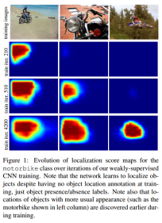
Related Works
Convolutional layers can localize objects.
The ability is lost when fully-connected(fc) layers used for classification.
Network in Network and GoogLeNet use fully convolutional network
avoid use of fc layers (except last layer)
Global pooling layer used as structural regularizer, preventing overfitting.
[Oquab et al 2015] use global max pooling to localize
Limited to point lying in the boundary of object rather tan full extent of object.
Today’s seminar: Learning Deep Features for Discriminative Localization
1512.04150v1 Zhou et al. 2015 CVPR2016
Is object localization for free? – Weakly-supervised learning with convolutional neural networks
arxiv Oquab et al. CVPR2015

Slide 8
Architecture
AlexNet+GAP+places205
Living room
11x11 Avg Pooling: Global Average Pooling (GAP)
227x227x3
11x11x512
512
205

Slide 9
Class activation map (CAM)
Identify important image regions by projecting back the weights of output layer to convolutional feature maps.
CAMs can be generated for each class in single image.
Regions for each categories are different in given image.
palace, dome, church …

Slide 10
Results
CAM on top 5 predictions on an image
CAM for one object class in images

Slide 11
GAP vs. GMP
Oquab et al. CVPR2015 Is object localization for free? weakly-supervised learning with convolutional neural networks.
Use global max pooling(GMP)
Intuitive difference between GMP and GAP?
GAP loss encourages identification on the extent of an object.
GMP loss encourages it to identify just one discriminative part.
GAP, average of a map maximized by finding all discriminative parts of object
if activations is all low, output of particular map reduces.
GMP, low scores for all image regions except the most discriminative part
do not impact the score when perform MAX
pooling

Slide 12
GAP & GMP
GAP (upper) vs GMP (lower)
GAP outperforms GMP
GAP highlights more complete object regions and less background noise.
Loss for average pooling benefits when the network identifies all discriminative regions of an object

Slide 13
Experiments!
AlexNet, VGGnet, GoogeLeNet : Trained with ImageNet from the scratch
All remove Fully Connected(FC) layers
Replace with GAP & FC softmax layer
Better if Conv layer before GAP has higher spatial resolution
mapping resolution
Removed last conv layer and add higher spatial resolution
Ex) VGGnet: Conv5-3 3x3x512 → 3x3x1024

Slide 14
AlexNet, VGGnet, GoogLeNet
Reminder on popular nets.
GoogeLeNet is most convolutional among these.
Performs the best

Slide 15
Classification
Classification error:
1~2% performance drop on Top-5
AlexNet-GAP drops with removal of FCs
GooLeNet-GMP & GooLeNet-GAP is similar
High classification performance is important to achieve good localization
as it involves identifying both object category and bounding box location

Slide 16
Localization
Generation of Bounding Box from CAM.
thresholding to segment the heatmap
20% of the max value of CAM, cover with bounding box.
on Top 5 predicted classes.
GT bounding box

Slide 17
Localization
Weakly vs. weakly
GoogLeNet-GAP beats GoogLeNet and GoogLeNet-GMP
Weakly-supervised!!
Not trained on single annotated box.
Weakly vs. fully-supervised
(heuristic)
loose bbox from top 3rd predicted class.
GoogLeNet-GAP is closed to AlexNet that learned supervised method.
Impressive but still behind fully-supervised.

Slide 18
Deep Features for Classification
Usage CNN features (fc6, fc7 of AlexNet) as a generic feature
→ Used as very powerful feature without training on the task.
Use the features learned by GAP CNN. Not trained for particular task!
Obtain weights by training a linear SVM on the output of GAP layer
similar to mapping weight to softmax layer
Compare performance.
GoogLeNet-GAP outperforms AlexNet.
GoogLeNet-GAP is competitive with the state-of-the-art as generic visual features.

Slide 19
Deep Features for Localization
Also localizable with CAM
Very effective for generating localizable deep features for generic tasks.

Slide 21
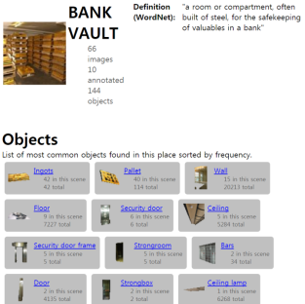
Scene Recognition + Localization
10 scene categories from SUN dataset. 4675 fully annotated images.
one-vs-all linear SVM for each scene category.
Compute the CAMs using the weights of the linear SVM.
Plot CAM for predicted scene category
list top 6 objects that most frequently overlap
High activations regions correspond to objects indicative of the particular scene category.

Slide 22
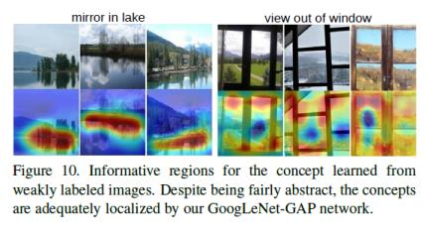
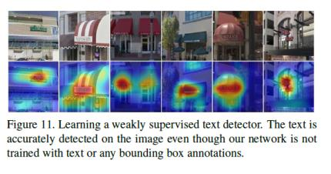
Concept localization
Concept localization in weakly labeled images
Positive set: short phrase in text caption
Negative set: randomly selected images
Model catch the concept, phrases are much more abstract than object name.
Weakly supervised text detector
Positive set: 350 Google Street View images that contain text.
Negative set: outdoor scene images in SUN dataset
Text highlighted without bounding box annotations.

Slide 23
Conclusion
General technique called Class Activation Mapping (CAM) with Global Average Pooling has been proposed
Classification-trained CNNs can learn object localization.
without bounding box annotations.
CAM is useful to visualize the predicted class scores.
Highlights discriminative object parts detected by CNN.
Weakly-supervised object localization on ILSVRC benchmark, and GAP-CNN can perform accurate object localization.
CAM localization technique generalized to other visual recognition tasks.
Generic localizable deep features applicable to various tasks.
Import object in scene, concept localization, text detection.

